Slide 1
Python in a Day
Session #1

Slide 2
Rob Carrington
4 years as a Python developer
Worked in FinTech (@Q2eBanking)

Slide 3



Q2

Slide 4
Projects
Recommendation System
Audience Segmentation
Predicting Overdrafts

Slide 5
Why Python?

Slide 6
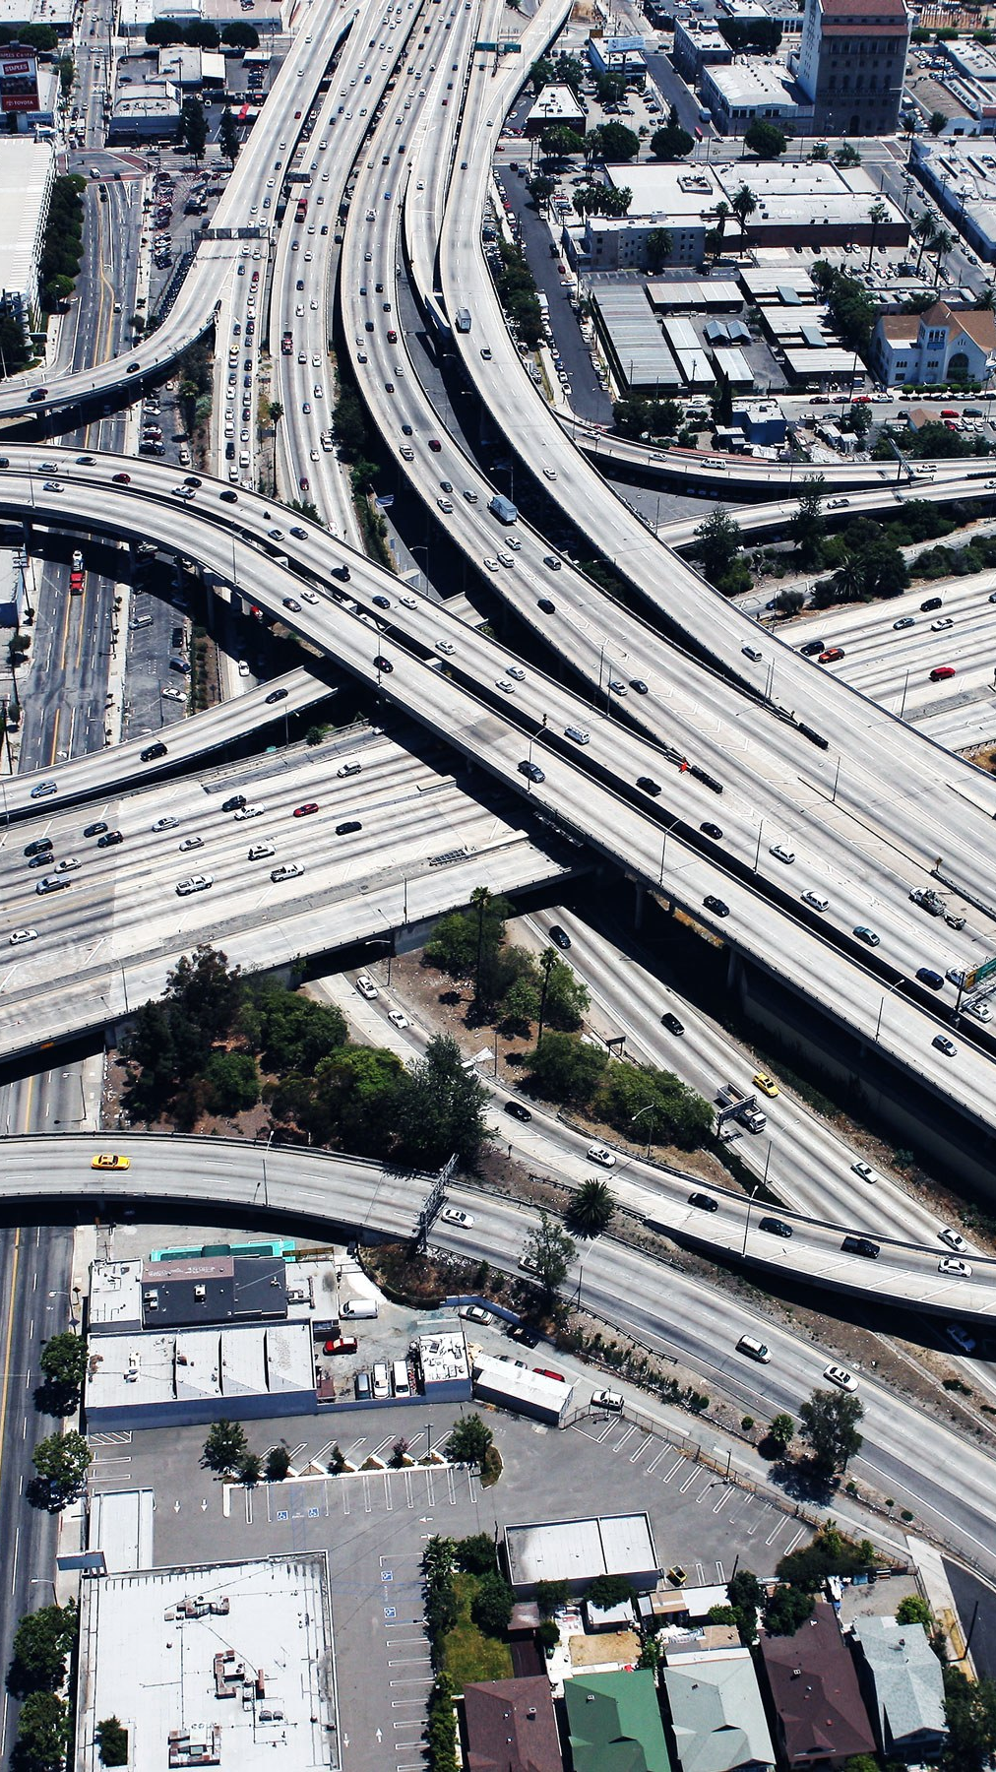
Infrastructure
Modern Software

Slide 7

Community
broad Open-Source

Slide 8
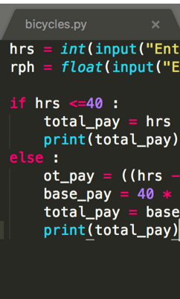
Code
Short, Readable

Slide 9

ME
What’s in it for

Slide 10
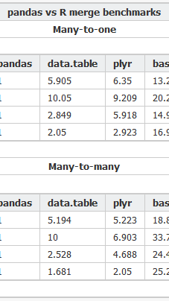
Automation
Spreadsheet

Slide 11

Web apps
Backend code for

Slide 12
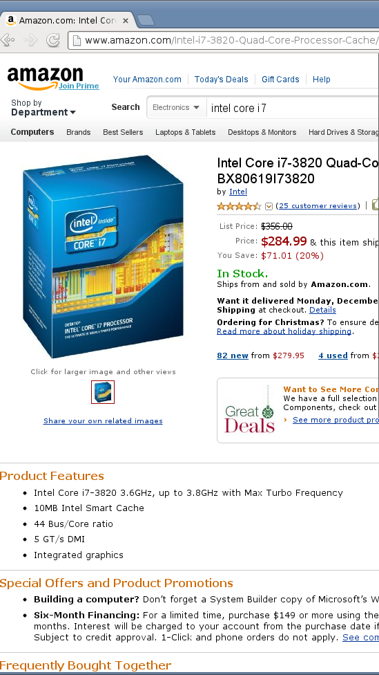
Webscraping
Gathering Data by

Slide 13
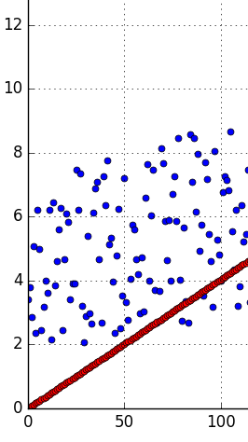
Data Science
Statistics and

Slide 14
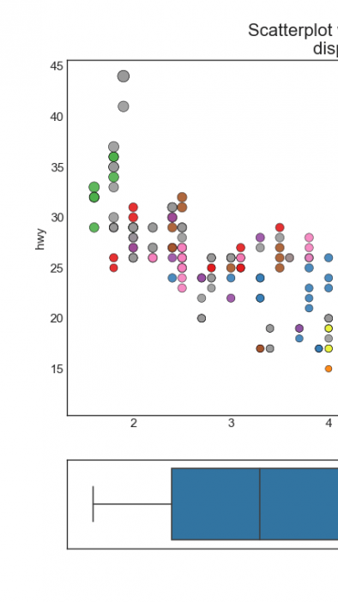
Visualizations
Creating data

Slide 15
Class format

Slide 16
Class format

Slide 17

Class format
10 minutes for lesson & demo
15 minutes for exercise
Pause to review & ask questions
Rinse and repeat

Slide 18
Fundamentals

Slide 19
How to think about Python
You are giving orders to your computer
Each order is called a “statement”

Slide 20
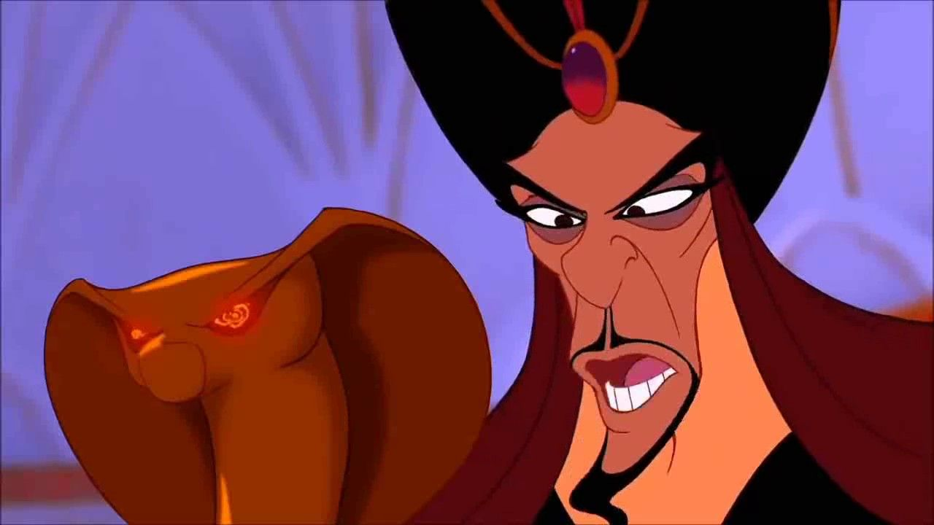
You
Python

Slide 21

Your Computer

Slide 22
ASSIgnment Statement
English:
remember “fav_number” means 3

Slide 23
ASSIgnment Statement
English:
remember “fav_number” means 3
arbitrary label

Slide 24
Assignment Statement
fav_number = 3

Slide 25
ASSIgnment Statement
fav_number = 3
variable

Slide 26
ASSIgnment Statement
fav_number = 3
value
variable

Slide 27
ASSIgnment Statement
fav_number = 3
variable
(integer literal)

Slide 28
Rules for Variables
Must start with a letter or underscore
Cannot start with a number
Only letters, numbers and underscores allowed
Variable names are case-sensitive

Slide 29
Variables
my_number

Slide 30
Variables
my_number

Slide 31
Variables
my_number
3amigos

Slide 32
Variables
my_number
3amigos

Slide 33
Variables
my_number
3amigos
left-handed

Slide 34
Variables
my_number
3amigos
left-handed

Slide 35
ExpressionS
An expression is part of a statement
Noun without a verb

Slide 36
Expression Examples
Variables (like fav_number)
Values (like 3)

Slide 37
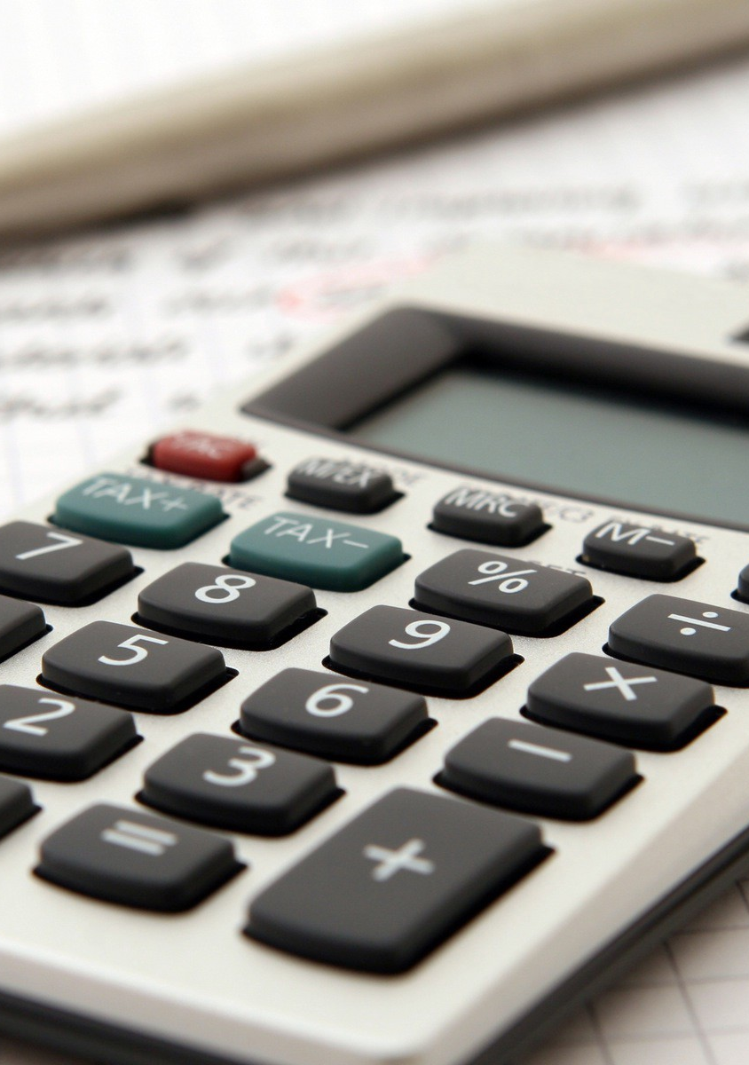
Python thinks like your calculator
If you enter 7 + 9, this is still an expression.
Equivalent to 16.

Slide 38
Expression Vs Statement
Equal to a single value —> expression

Slide 39
Expression Vs Statement
Equal to a single value —> expression
Important to know when you’re giving an order vs noun

Slide 40
Why Do I care about calculators?
Compare to Excel formulas
Find compound interest, etc

Slide 41
Old Friends
Integers (called “int”)
Decimals (called “float”)

Slide 42
Old Friends
Addition (+)
Multiplication (*)
Division (/)
Exponents (**)

Slide 43
A New Friend
Modulo (%)
Finds the remainder

Slide 44
Concepts covered so Far
Statement
Expression
Variable
Int, Float

Slide 45
Exercises

Slide 46
New Data Type: String
Text wrapped in quotes
Only meaningful to humans

Slide 47
String Example
greeting = “hello world!”

Slide 48
String Example
greeting = “hello world!”
value

Slide 49
String Example
greeting = “hello world!”
(string literal)

Slide 50
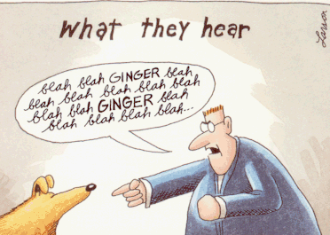

Slide 51
Indexing Syntax
English:
get the first letter in my_string

Slide 52
Indexing Syntax
my_string[0]

Slide 53
Indexing Syntax
English translation:
get the seventh letter in my_string

Slide 54
Indexing Syntax
my_string[6]

Slide 55
Indexing Syntax
English:
get the last letter in my_string

Slide 56
Indexing Syntax
my_string[-1]

Slide 57
Slice Syntax
English:
get the first four letters of my_string

Slide 58
SLICE Syntax
my_string[0:4]

Slide 59
SLICE Syntax
my_string[0:4]
not included!

Slide 60
Slice Syntax
English:
get all the letters up to the third

Slide 61
SLICE Syntax
my_string[:3]

Slide 62
Slice Syntax
English:
grab from the third element through until the end

Slide 63
SLICE Syntax
my_string[2:]

Slide 64
Slice: step
[start_index:end_index]

Slide 65
Slice: step
[start_index:end_index:step]

Slide 66
Slice: step
my_list[::2]

Slide 67
Slice: step
my_list[::2]
even # items in list

Slide 68
Slice: step
my_list[1::2]

Slide 69
Slice: step
my_list[1::2]
odd # items in list

Slide 70
Slice: step
my_list[::-1]

Slide 71
Slice: step
my_list[::-1]
reverse list

Slide 72
Exercises

Slide 73
F-Strings
Text with variables injected
Normal string but with an “f” before the quotes

Slide 74
F-strings
my_name = “rob”

Slide 75
F-strings
f“Hello, {my_name}!”

Slide 76
F-strings
f“Hello, {my_name}!”
“Hello, Rob”

Slide 77
Print Statement
English:
Print my_name on the screen

Slide 78
Print Statement
English:
Print my_name on the screen
(Useful for peeking into variables)

Slide 79
print Statement
print(my_name)

Slide 80
print Statement
print(my_name)
function

Slide 81
print Statement
print(my_name)
function
input (aka argument)

Slide 82
Function
Performs an action
Action in example: print to screen

Slide 83
Function vs method
Same: performs an “action” with input
Different: where input comes from

Slide 84
method Example
“Rob”.replace(“R”,“B”)

Slide 85
method Example
“Rob”.replace(“R”,“B”)
“Bob”

Slide 86
method Example
“Rob”.replace(“R”,“B”)
method on string

Slide 87
Function vs method
Input between parentheses
print(“Rob”)
“Rob”.replace(“R”,“B”)

Slide 88
Function vs method
Input between parentheses
print(“Rob”)
Main input before dot
“Rob”.replace(“R”,“B”)

Slide 89
Values: What kinds ARE THERE?
Int
Float
String

Slide 90
Mixing data types
1 + 7.2 = 8.2

Slide 91
Mixing data types
1 + 7.2 = 8.2
1 + “7.2” = error

Slide 92
Mixing data types
1 + 7.2 = 8.2
1 + int(“7.2”) = 8.2

Slide 93
Casting between Data types
int()
float()
str()

Slide 94
Concepts covered so Far
Print statement
Function
Method
Casting

Slide 95
Exercises

Slide 96
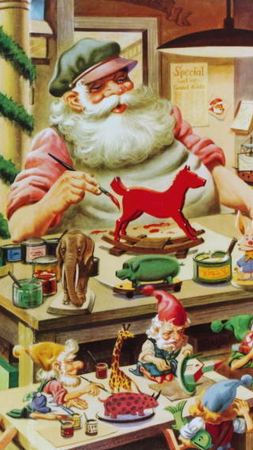
Functions
Defining your own

Slide 97
Defining a Function
Reusable chunk of code

Slide 98
Defining a Function
Reusable chunk of code
Build action from basic functions

Slide 99
Defining A Function
def double(my_name):
answer = my_name + my_name
return answer

Slide 100
Defining A Function
def double(my_name):
answer = my_name + my_name
return answer

Slide 101
Defining A Function
def double(my_name):
answer = my_name + my_name
return answer

Slide 102
Defining A Function
def double(my_name):
answer = my_name + my_name
return answer
arbitrary label for input

Slide 103
Defining A Function
colon
def double(my_name):
answer = my_name + my_name
return answer

Slide 104
Defining A Function
def double(my_name):
answer = my_name + my_name
return answer

Slide 105
Defining A Function
def double(my_name):
answer = my_name + my_name
return answer
indented block

Slide 106
Defining A Function
def double(my_name):
answer = my_name + my_name
return answer

Slide 107
Calling A Function
double(“Rob”)

Slide 108
Calling A Function
double(“Rob”)
no space

Slide 109
Calling A Function
double(“Rob”)
“RobRob”

Slide 110
Exercises

